Slide 1
Protein Expression and Proteomics (PEP) Core Update
New Staff and Location
Expansion of current capabilities
Addition of new services offered

Slide 2
PEP Core Goals Overview
Facilitate cloning, expression and purification of proteins of interest
Maintain inventory of viral protein vectors and proteins for immediate use (have viral and cellular proteins ready for use – will list on website)
Perform analysis of CFAR samples (including mass spectrometry, protein gels, western blot, and Luminex (BioPlex)-based analyses)
Provide advice in all aspects of protein production and analysis to CFAR community (no cost)

Slide 3
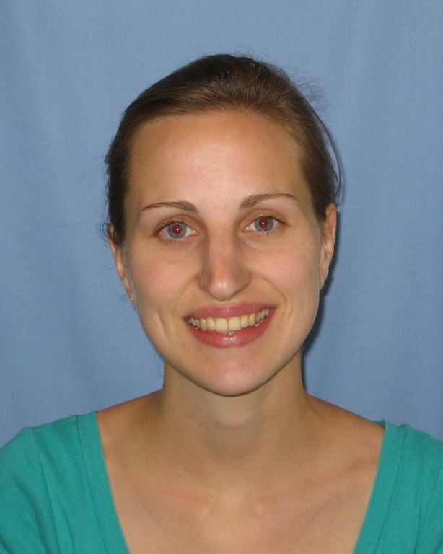
Protein Expression and Proteomics (PEP) Core Update
New Location and Staff:
PEP Core Staff Scientist and main contact:
Johanna Heideker, Ph.D.
New administrative assistant: Jovelyn Slivka.
We are moving to the Immunology Building 115/116 Dec
New website content

Slide 4
PEP Core Update
Expansion of current capabilities:
2 new FPLC systems for protein production:
BioRad DuoFlow and GE AKTA 950
Updating Bio-Rad (Luminex) with current software
Current MS Scripps at La Jolla, and now Florida
Discussions ongoing to secure additional mass spec time/instrumentation at Sanford Burnham Prebys
Equipment grant from UCSD – CFAR for mass spec?

Slide 5
PEP Core Update
Addition of New Services:
Crystallography support services
In addition to providing structural biology-grade proteins we will provide automated crystal screening and data collection service at the Stanford beamline (SSRL).
Protein Posttranslational Modification analysis
Analysis will be performed via mass spec and or gel analysis including identification of phosphorylation and acetylation sites, analysis of chain specific ubiquitination, and neddylation.

Slide 6
PEP Core Update
Addition of New Services:
In-vivo functional activity/infectivity assays for screening new viral inhibitors
We are BSL3 certified and maintain an inventory of HIV and other viral clones to support cellular screening projects for new HIV inhibitors.
In-vitro enzyme activity assays
A wide variety of activity / inhibitor screening assays targeting viral and host enzymes can be made available and co-developed with our expertise in protein purification, activity-based protein profiling, mass spectrometry, and automation equipment.

Slide 7
PEP Core Activity
Investigator Project
Lewinski, Mary (UCSD) NIH Mass spectrometry analysis of cells expressing HIV +/- accessory genes
Olson, Arthur J. (TSRI) NIH Gag and capsid protein production for SuFEX screening
Williamson, James &
Torbett, Bruce Edward (TSRI) NIH Gag protein production & mass spectrometry analysis of Gag cellular pulldowns

Slide 8
PEP Core Activity
Investigator Project
Heinz, Sven (UCSD) Dev Grant Developing a genomic tool kit to study clinical responses to HIV infection and treatment Provided advice on the application and I am the co- mentor on the application. Will provide CFAR support.
Deshmukh, Lalit (UCSD) Dev Grant Biophysical characterization of the role of capsid-dependent restriction factor, MxB, in inhibition of HIV-1 uncoating. Advice and protein production

Slide 9
PEP Core Activity
Investigator Project
Deshmukh, Lalit (UCSD) Gilead Scholar Targeting the transient dark state of HIV-1 nucleocapsid with small drug-like molecules.
Mentor and protein production.
Kim, Jeong Ho
(Xycrobe Therapeutics,JLAB) Company Detection of cytokines in human sera using the Luminex.
Case, Jamie (Scripps Center Scripps Health Detection of cytokines in
For Organ & Cell Transplantation) chronic venous insufficiency
using the Luminex.

