Slide 1

Protein Expression and Proteomics (PEP) Core Update
Staff and Location
Addition of new services offered

Slide 2
PEP Core Goals Overview
Facilitate cloning, expression and purification of proteins of interest
Maintain inventory of viral protein vectors and proteins for immediate use (have viral and cellular proteins ready for use, listed on website)
Perform analysis of CFAR samples (including mass spectrometry, protein gels, western blot, and Luminex (BioPlex)-based analyses)
Provide advice in all aspects of protein production and analysis to CFAR community (no cost)

Slide 3
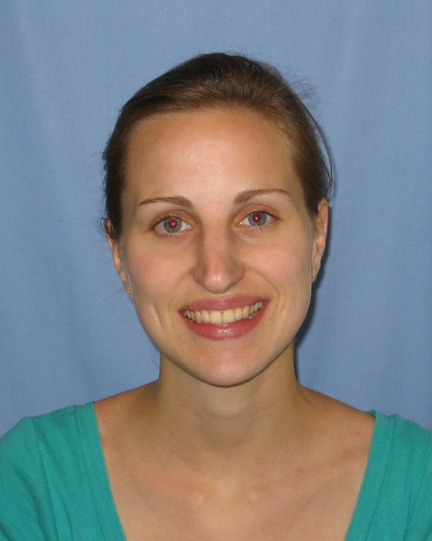
Protein Expression and Proteomics (PEP) Core Update
New Location and Staff:
PEP Core Staff Scientist and main contact:
Johanna Heideker, Ph.D.
New administrative assistant: Jovelyn Slivka.
We are moving to the Immunology Building 115/116 Dec
New website content

Slide 4
PEP Core Update
Expansion of current capabilities:
FPLC systems for protein purification:
BioRad DuoFlow and GE AKTA 950
Updating BioPlex 200 (Luminex) with newest software and providing workstation for data analysis to users
Mass Spec capabilities at Scripps La Jolla and Florida

Slide 5
PEP Core Update
Addition of New Services:
Crystallography support services
In addition to providing structural biology-grade proteins we will provide automated crystal screening and data collection service at the Stanford beamline (SSRL).
Protein Posttranslational Modification analysis
Analysis will be performed via mass spec and or gel analysis including identification of phosphorylation and acetylation sites, analysis of chain specific ubiquitination, and neddylation.

Slide 6
PEP Core Update
Addition of New Services:
In-vivo functional activity/infectivity assays for screening new viral inhibitors
We are BSL3 certified and maintain an inventory of HIV and other viral clones to support cellular screening projects for new HIV inhibitors.
In-vitro enzyme activity assays
A wide variety of activity / inhibitor screening assays targeting viral and host enzymes can be made available and co-developed with our expertise in protein purification, activity-based protein profiling, mass spectrometry, and automation equipment.

Slide 7
PEP Core Update
Addition of New Services:
Technical hands-on seminars for BioPlex users
Training will be performed at the PEP Core in collaboration with certified BioRad proteomics specialists for BioPlex sample preparation, assay design, running the experiment, and data analysis using DataPro.
Hands-on training for mass spectrometry sample preparation
Users of our PEP Core mass spec services can obtain MS sample preparation training at our core including for PTM scans, TMT-multiplexing, in-gel digestion, and on obtaining high quality SILAC samples.

Slide 8
Current PEP Core Activity
Investigator Funding Source Project
Lewinski, Mary (UCSD) NIH Mass spectrometry analysis of cells expressing HIV +/- accessory genes
Olson, Arthur J. (TSRI) NIH Gag and capsid protein production for SuFEX screening
Williamson, James &
Torbett, Bruce Edward (TSRI) NIH Gag protein production & mass spectrometry analysis of Gag cellular pulldowns

Slide 9
Current PEP Core Activity
Investigator Funding Source Project
Heinz, Sven (UCSD) Dev Grant Developing a genomic tool kit to study clinical responses to HIV infection and treatment
Deshmukh, Lalit (UCSD) Dev Grant Biophysical characterization of the role of capsid-dependent restriction factor, MxB, in inhibition of HIV-1 uncoating.

Slide 10
Current PEP Core Activity
Investigator Funding Source Project
Deshmukh, Lalit (UCSD) Gilead Scholar Targeting the transient dark state of HIV-1 nucleocapsid with small drug-like molecules.
Kim, Jeong Ho
(Xycrobe Therapeutics, JLAB) Company Detection of cytokines in human sera using the Luminex.
Case, Jamie (Scripps Center Scripps Health Detection of cytokines in
For Organ & Cell Transplantation) chronic venous insufficiency
using the Luminex.

