Slide 1
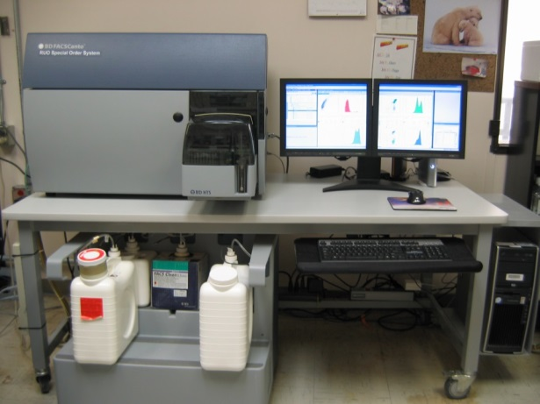
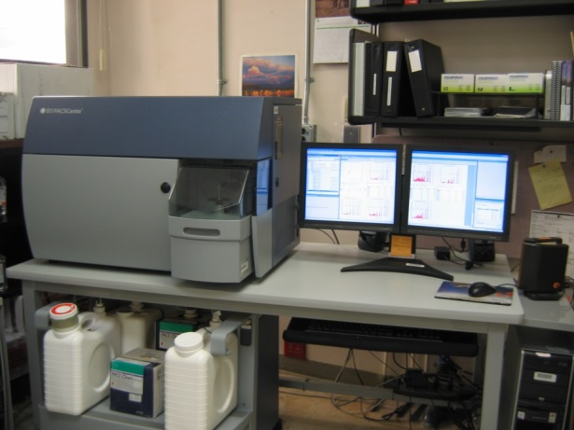
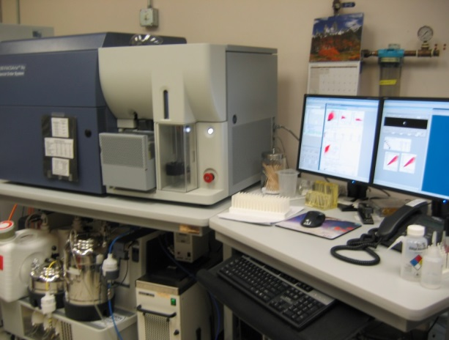
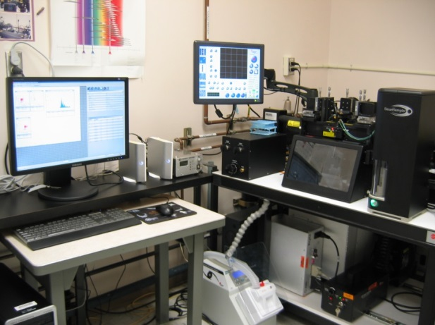
BD FACSCanto RUO - ORANGE (Analyzer)
Lasers: Blue-488nm, Red-640nm, Violet-405nm
up to 11 Colors
96-well High Throughput System (HTS)
BD FACSCanto RUO - GREEN (Analyzer)
Lasers: Blue-488nm, Red-640nm, Violet-405nm
up to 11 Colors
Carousel Loader System
BD FACSAria II (High Speed Sorter)
Lasers: Blue-488nm, YG-561 nm, Red-640nm, Violet-405nm
up to 11 Colors
Bulk Sorting (2 or 4-way sorting)
Clone Sorting (1 or more cells/well)
Biohazardous Sorting
MoFlo XDP (High Speed Sorter)
Lasers: Blue-488nm, Red-640nm, UV-355nm
up to 10 Colors
Bulk Sorting (2 or 4-way sorting)
Clone Sorting (1 or more cells/well)
Biohazardous Sorting

